Slide 1
Donate me!
Group 4
Alexandre Souza Santos
Chad Mandy
Harold Davis

Slide 2
Overview
Introduction
Storyboard
Student Interaction and Inspiration
Processing Integration
External APIs
Assets
Marketing Video
Application Demo

Slide 3
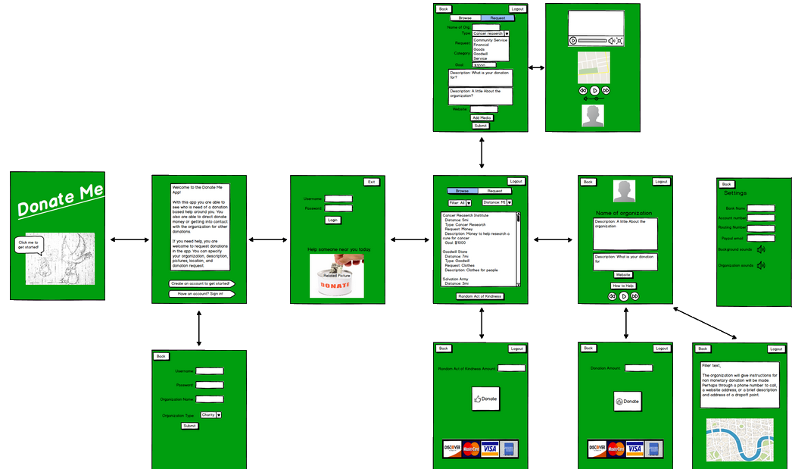
Storyboard

Slide 4
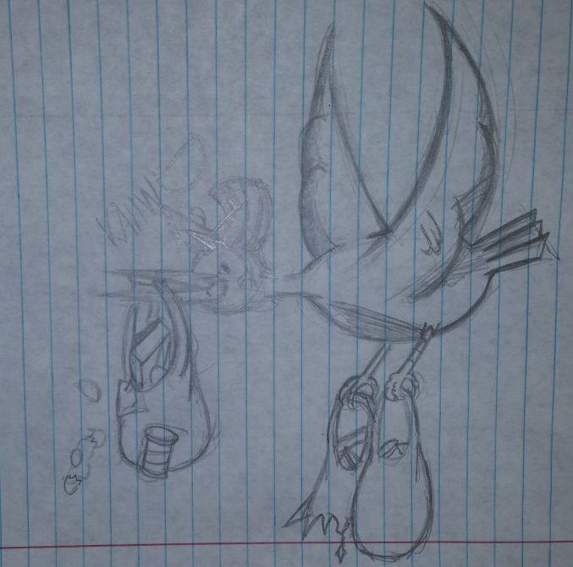
Student Interaction
We initially met with the Gulfstream Middle School students to brainstorm application ideas
Giovanni
Sidney
Anthony
Danny
A second interaction with the kids allowed us to refine the UI
Bridigit
Imani

Slide 5
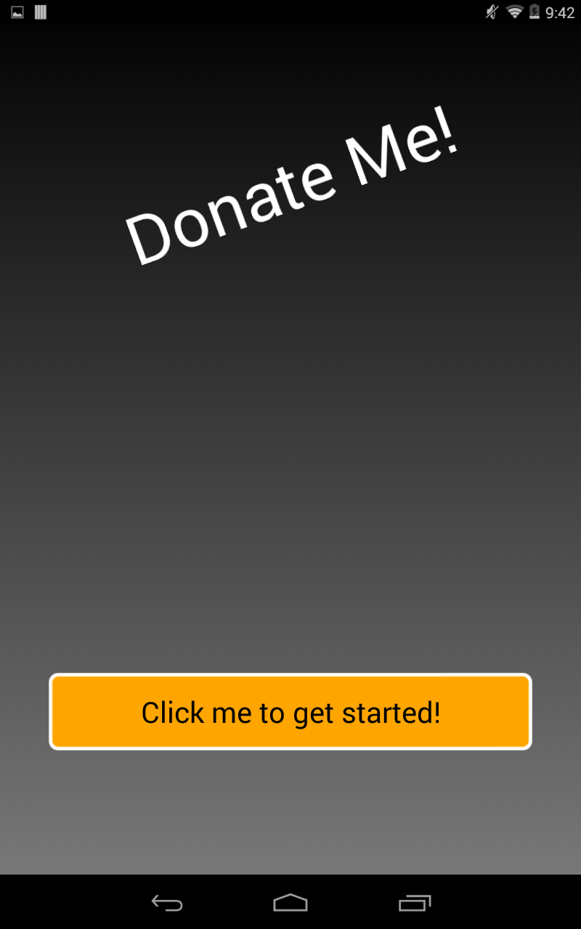
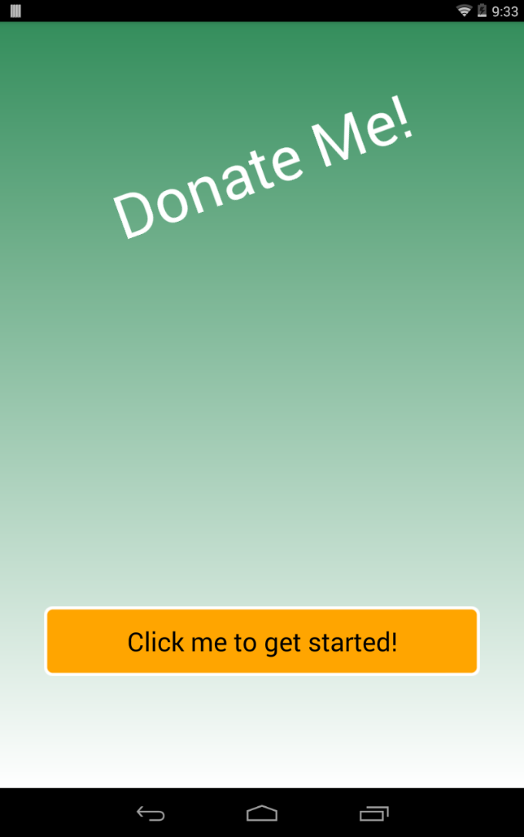
Processing Integration
Created an application hook to processing to allow direct customization
Background Color Gradients
Filters
Media

Slide 6
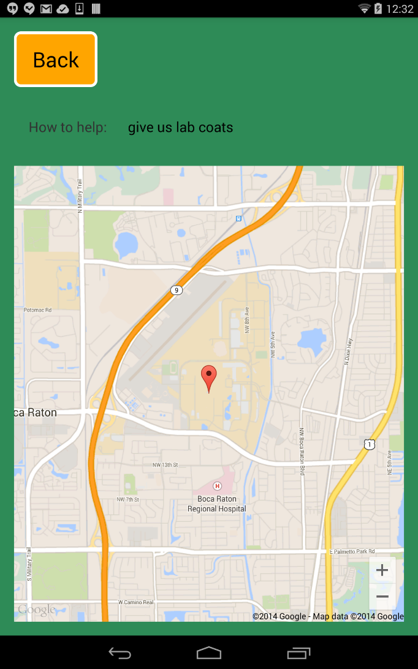
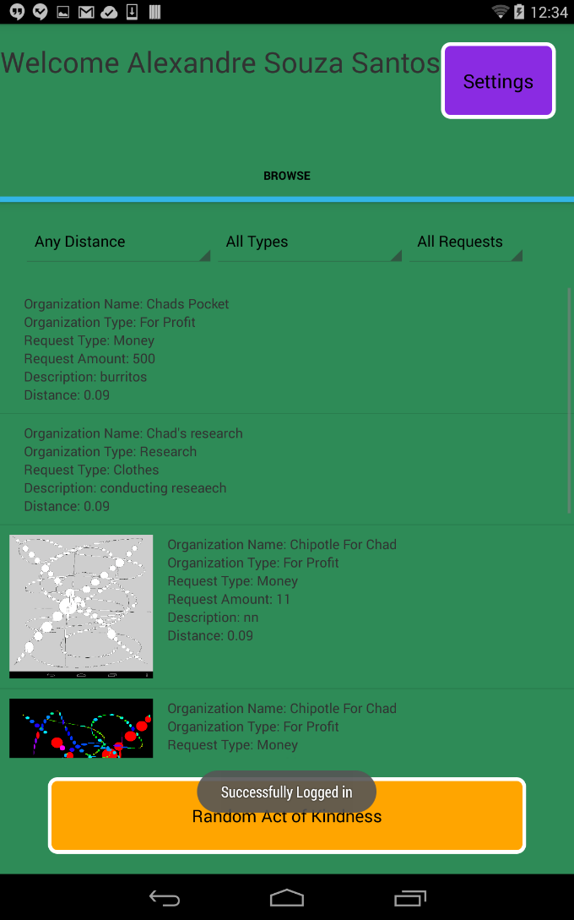
External APIs
Parse
Google Maps
Paypal-MPL

Slide 7
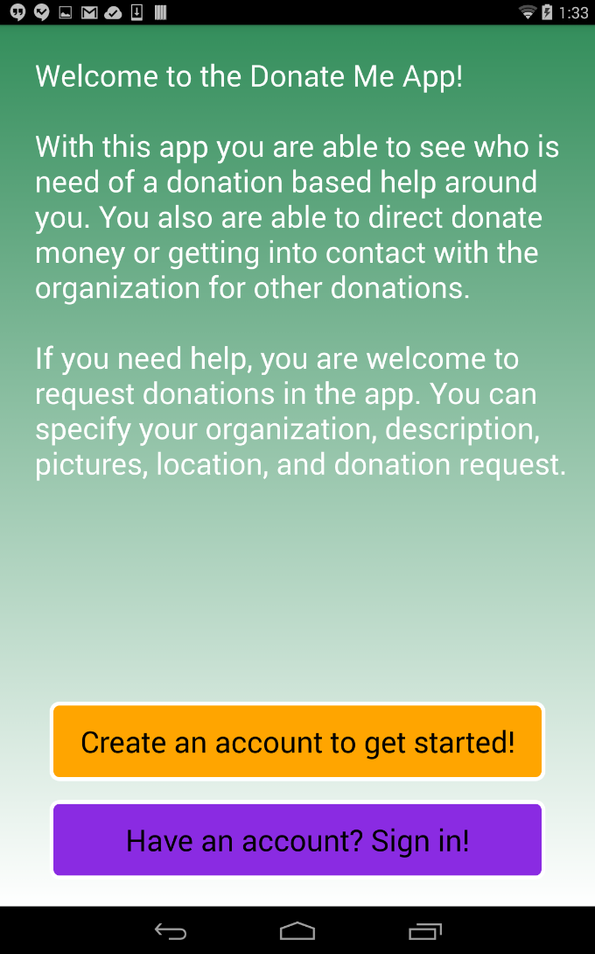
Assets
Responsive UI Design
Embedded persistent background audio
Kid friendly style

Slide 8
